Slide 1

Chapter 4 Part I
Time-Dependent Failure Models
Weibull’s wobble but they don’t fall down!
-old English saying
The Weibull Distribution
Minimum Extreme Value Distribution
Chapter 4
Notes:
While the CFR model is perhaps the simplest in its mathematical structure, it has limited application. Obviously, not all failures modes have constant failure rates. Three important failure distributions are the Weibull, normal, and lognormal having non-constant failure rates.

Slide 2
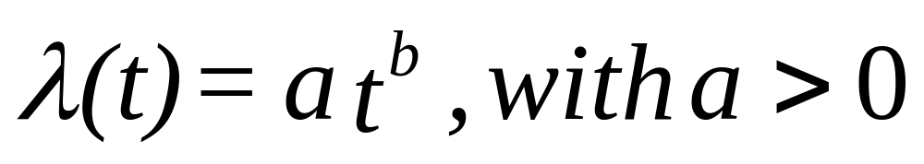
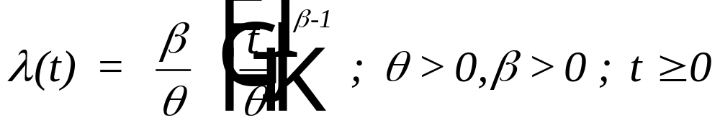


Time Dependent Failure Mode
rewrite as:
where
is the shape parameter and
is the characteristic life
Chapter 4
Notes:
We begin with the Weibull distribution named after the individual who first suggested its use as a failure distribution. We can derive the Weibull in much the same way the exponential was derived by starting with an assumption on the mathematical form of the hazard rate function. If the hazard rate function is not constant, then the next simplest mathematical form to assume is the linear. Rather than analyze just the linear form, we generalize it somewhat to be a power function. The hazard rate will be linear if b = 1 in the above equation. A good exercise is to repeat the analysis that follows for the special case in which b = 1. A simpler reliability function can be derived if the parameters of the hazard rate function are defined as shown in the second equation.

Slide 3
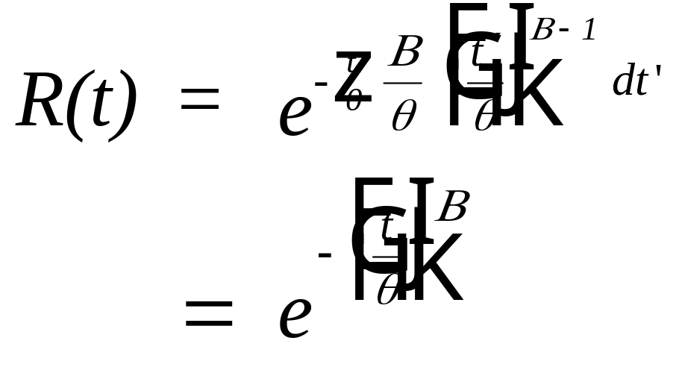
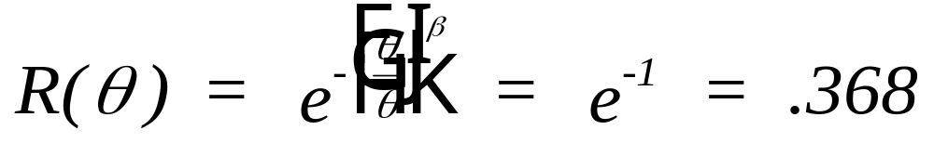
Reliability Function
note that:
Chapter 4
Notes:
Using again our favorite formula from Chapter 2, we can derive the reliability function from the hazard rate function. Note that the Weibull is a two-parameter distribution. Both the shape and scale parameter must be determined in order to completely specify the failure distribution. Methos for estimating the parameters of these distributions will be discussed in Part 2 of the text. One interpretation of the scale parameter of the Weibull is that it is that time at which 63.2 percent of the failures will have occurred. This is true regardless of its value or the value of the shape parameter.

Slide 4
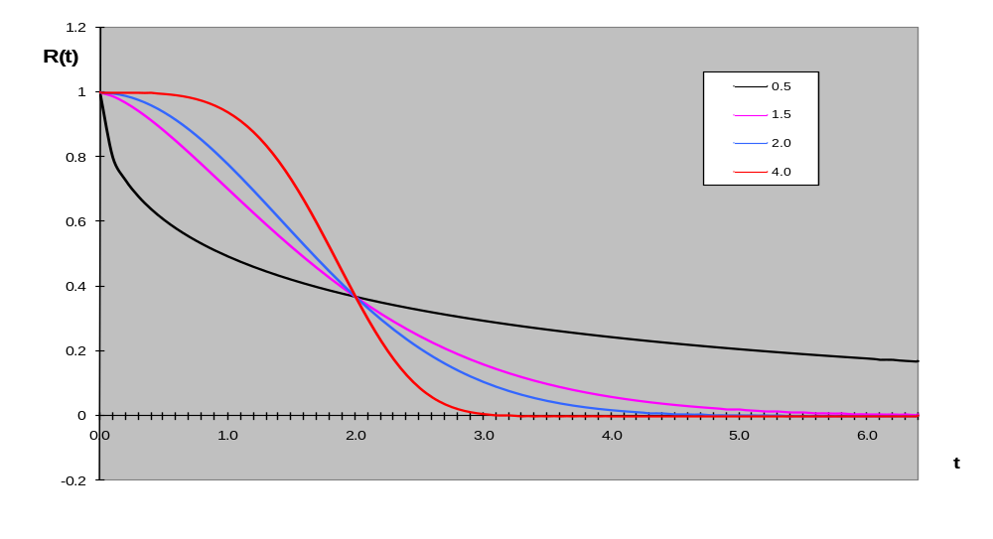
Graph of the Reliability Function
Beta
Theta = 2
Chapter 4
Notes:
Plotted are four Weibull distributions each having different shape parameters but sharing the same characteristic life. Why do all four pass through the same point?

Slide 5
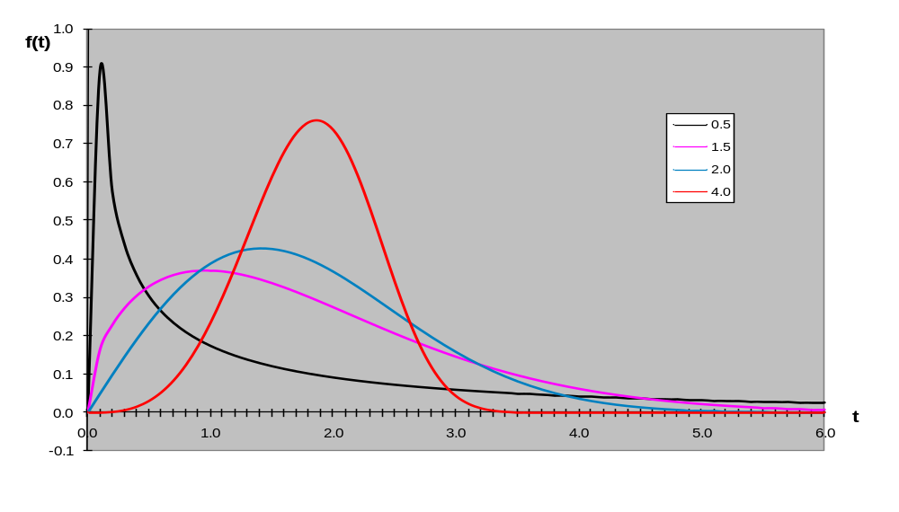
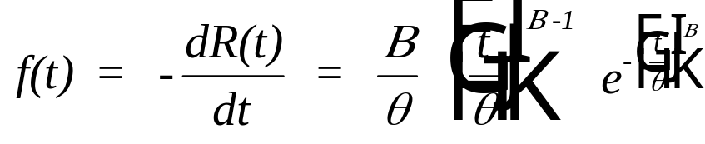
The Probability Density Function (PDF)
Beta
Theta = 2
Chapter 4
Notes:
Taking the negative of the derivative of the reliability function will give us the density function. From the plot of the density functions, four somewhat significantly different shapes can be observed. (Now we know why beta is called the shape parameter). The fact that the Weibull can take on such radically different shapes is one reason for its widespread use.

Slide 6
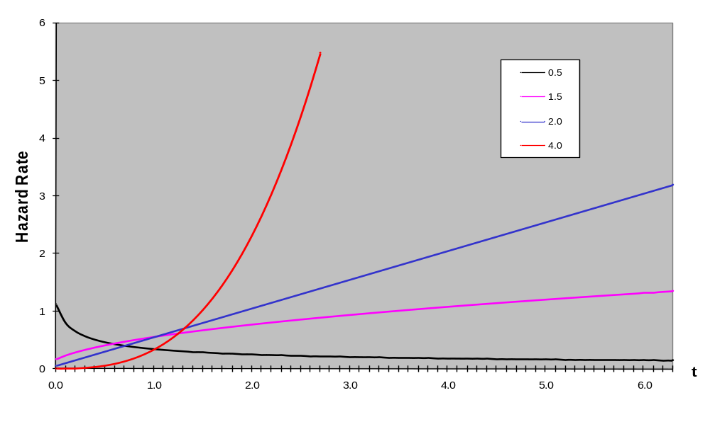
The Hazard Rate Function
Theta = 2
Beta
f(t) / R(t)
Chapter 4
Notes:
A plot of the hazard rate function may suggest that the Weibull is IFR for beta greater than one and DFR for beta less than one. Of course, analyzing the function itself should tell us this. What happens when beta = 1?

Slide 7
Weibull Shape Parameter
Value Property
0 < β < 1 Decreasing Failure Rate (DFR)
β = 1 Exponential Distribution (CFR)
1 < β < 2 IFR-concave
β = 2 Rayleigh Distribution (LFR)
β > 2 IFR - Convex
3 <= β <= 4 IFR - Approaches Normal
Distribution - Symmetrical
β = 3.43927
Most closely approximates the normal
β = 3.43938
Mean = median
Chapter 4
Notes:
Here is a summary of the characteristics of the Weibull as determined by the value of its shape parameter. Can you compare the shape of a convex hazard rate function to a concave hazard rate function? What are the implications with respect to the failure process?

Slide 8
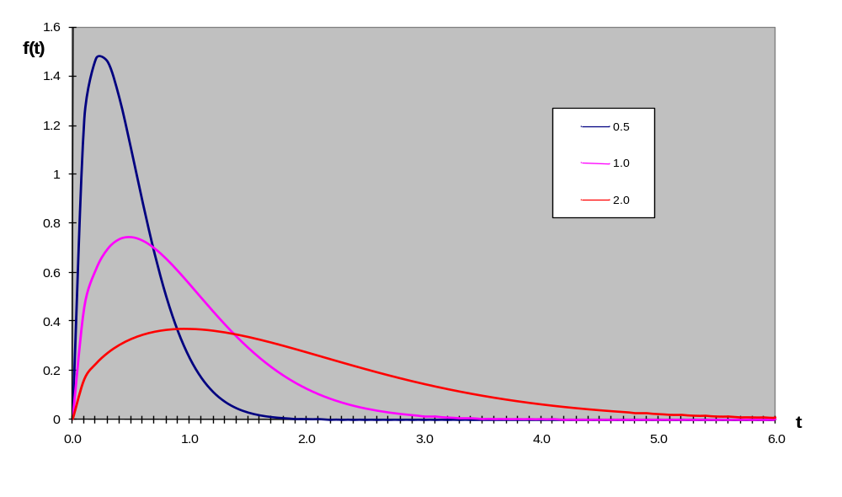
The Characteristic Life
Theta
Beta = 1.5
Chapter 4
Notes:
Varying the characteristic life, theta, does not change the shape of the distribution; however, it does change its mean, median, mode, and variance.

Slide 9
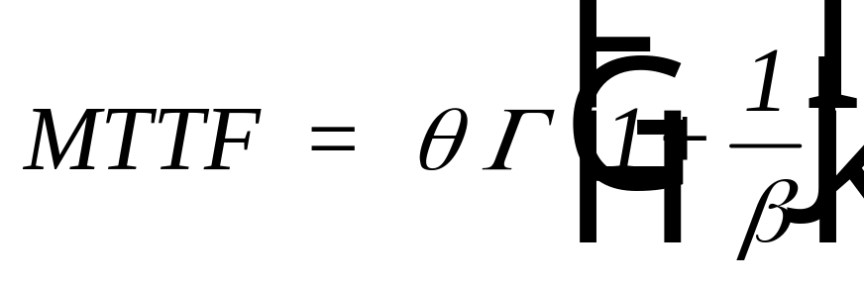

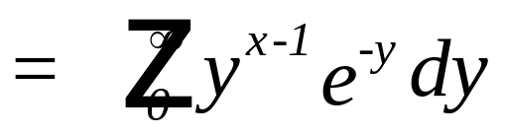
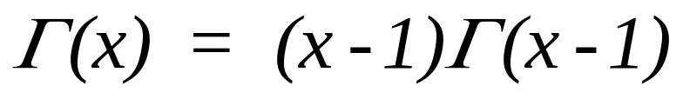
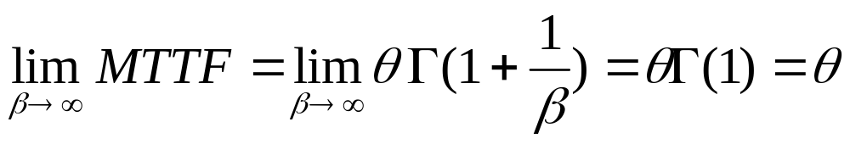
The Mean Time to Failure (MTTF)
Chapter 4
Notes:
Since we mentioned the mean, here is the formula for finding it. Because numerical integration is involved, the MTTF is more difficult to find than it was for the exponential. There is no simple formula. However, the integration can be expressed in terms of the gamma function and use made of a table of gamma values. An example of a gamma table is provided in the next slide and may be found in an appendix to your text. Be sure understand how to use the table and how to evaluate the gamma function. Note that the mean approaches the characteristic life as beta increases.

Slide 10
Gamma Function - selected values
x Gamma(x)
1.53 .88757
1.54 .88818
1.55 .88887
1.56 .88964
1.57 .89049
1.58 .89142
1.59 .89243
1.6 .89352
1.61 .89468
1.62 .89592
1.63 .89724
1.64 .89864
1.67 .9033
1.68 .905
1.69 .90678
x Gamma(x)
2.23 1.12023
2.24 1.12657
2.25 1.133
2.26 1.13954
2.27 1.14618
2.28 1.15292
2.29 1.15976
2.3 1.16671
2.31 1.17377
2.32 1.18093
2.33 1.18819
2.34 1.19557
2.35 1.20305
Chapter 4
Notes:
Selected gamma values. The highly motivated (but not necessarily bright) student will memorize the gamma table.

Slide 11

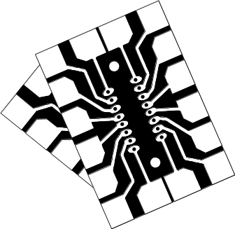
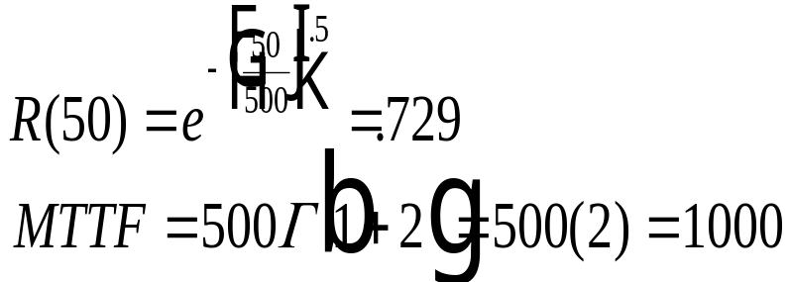
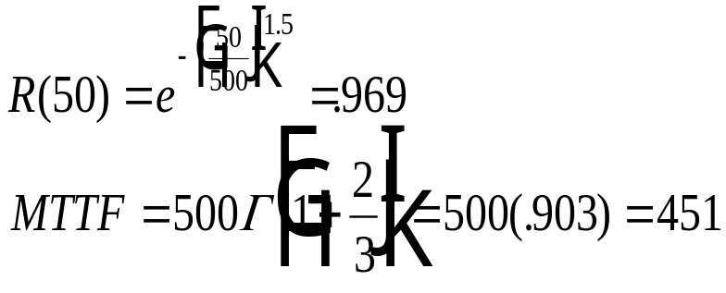
Example Problems
Let T = a random variable, the time to failure of a circuit card T has a Weibull distribution with beta equal to .5 and theta equal to 500 (thousands of hours).
Find R(50,000) and the MTTF.
Let T = a random variable, the time to failure of a fuse.
T has a Weibull distribution with beta equal to 1.5 and theta equal to 500 (thousands of hours).
Find R(50,000) and the MTTF.
Chapter 4
Notes:
Ahhhh! Our first example, and it is about time. Two Weibull distributions are given. One with a DFR and one with an IFR.

Slide 12
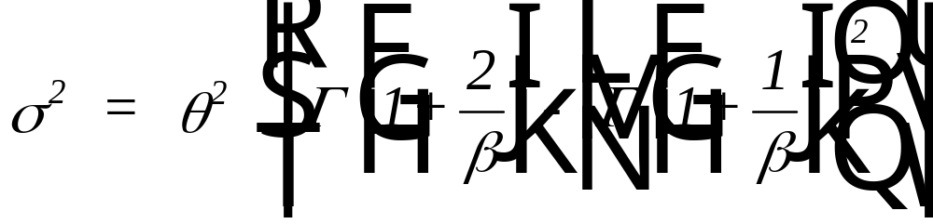
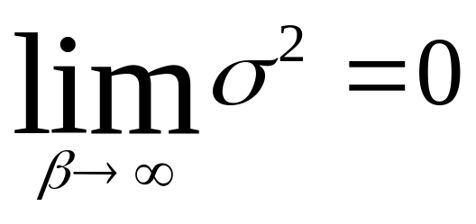
The Variance and Standard Deviation
Note:
Chapter 4
Notes:
Once the mean of a distribution is presented, the variance cannot be too far behind. Here it is. Again the gamma! As beta increases, the variance decreases. Does this result have any practical use?

Slide 13
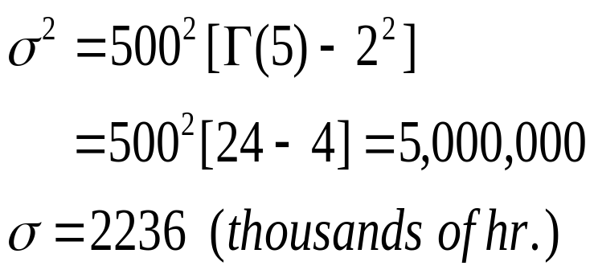
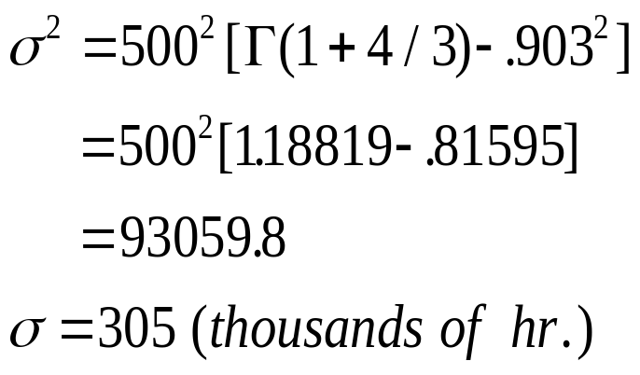
Example Problem - standard deviation
Chapter 4
Notes:
Be sure you can find the variance of a Weibull distribution.

Slide 14
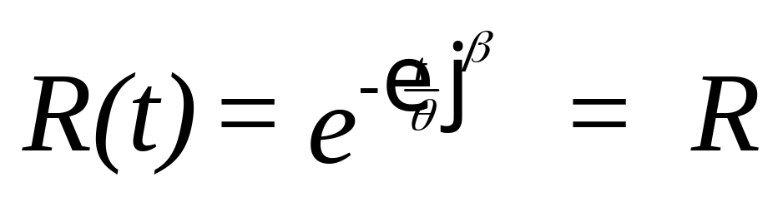
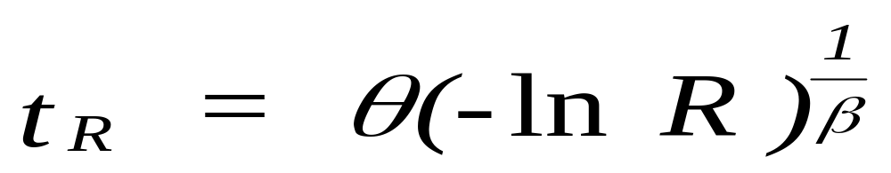
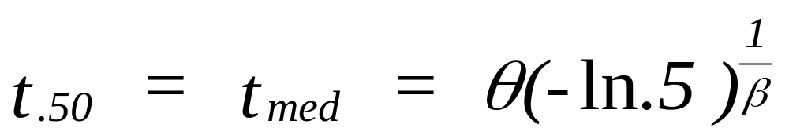
Design Life and Median
set
then
and
Chapter 4
Notes:
Solving the reliability function for its inverse gives us the design life. A design life where R = .5 is the median. Often design lives of one percent or .1 percent are of interest. What would they be for our two examples?

Slide 15
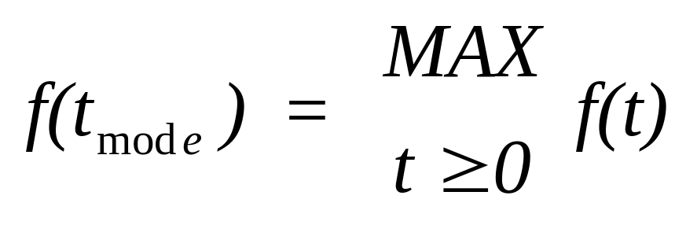
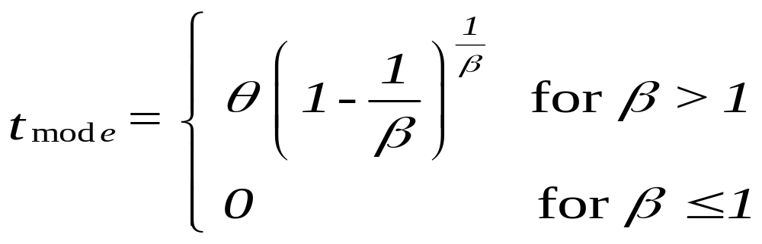
The Mode
Chapter 4
Notes:
The mode will occur at the origin for beta less than or equal to 1. As an exercise, find derive the above formula for the case where beta is greater than one. If your stuck, go to Appendix 4B.

Slide 16
Example - design life, median, & mode
beta = .5
t_{.9} = 500 (-ln.90)²
= 5.55 (1000 hr.)
t_{med} = 500 (.69315)²
= 240 (1000 hr.)
t_{mode} = 0
beta = 1.5 = 3/2
t_{.9} = 500 (-ln.90)^{2/3}
= 111.5 (1000 hr.)
t_{med} = 500 (.69315)^{2/3}
= 391.6 (1000 hr.)
t_{mode} = 500 [1-2/3)]^{2/3}
= 240 (1000 hr.)
Chapter 4
Notes:
Compare the two distributions remembering that they have the same value for theta. Note the significant differences caused by the shape parameter.

Slide 17
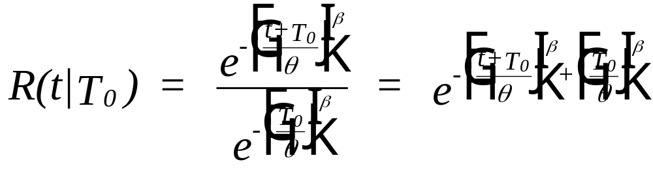
Conditional Reliability
Chapter 4
Notes:
Using the formula for a Weibull conditional reliability, find R(50|50) for both example distributions. Compare your results with R(50). The answer is on the next slide.

Slide 18
Example - conditional reliability
Beta = .5; R(50) = .7289
R(50|50) = R(100)/R(50) =exp[-(100/500)^{.5}] / .7289
= .6394 / .7289 = .8772
Beta = 1.5; R(50) = .969
R(50|50) = R(100)/R(50) =exp[-(100/500)^{.1.5}] / .969
= .9144 / .969 = .9437
Chapter 4
Notes:
Did you get the right answers? If not, is your mistake conceptual, mathematical, or simply bad arithmetic? Conceptual – see your instructor; mathematical – continuing reviewing freshman algebra and calculus; bad arithmetic – get a new calculator.

Slide 19
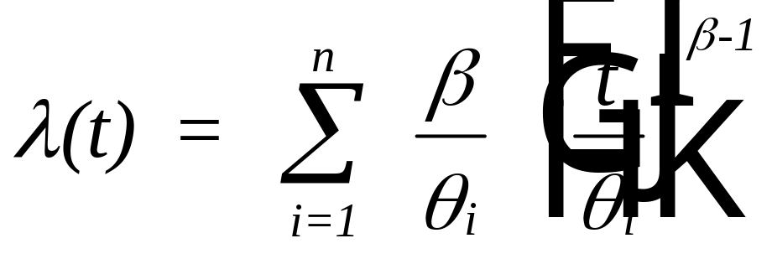
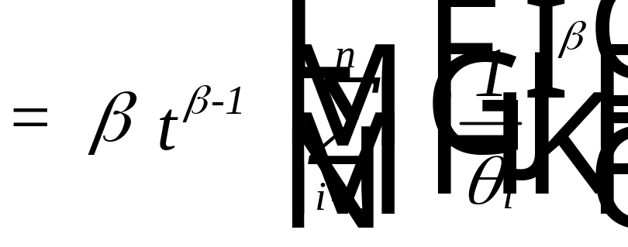

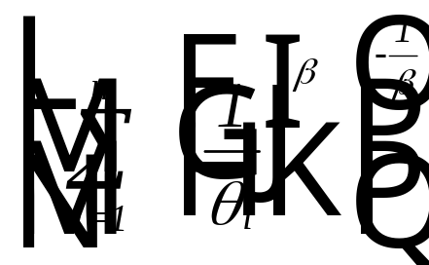
Failure Modes
which is a Weibull hazard rate function with a
shape parameter of and a characteristic life of
Chapter 4
Notes:
A system composed of several independent failure modes each having a Weibull failure distribution will have a system hazard rate function equal to the sum of the failure mode hazard rate functions. If all failure modes have the identical shape parameter, then the system will have a Weibull distribution as well. Do you see where the scale parameter came from? What happens when each failure mode has a different beta value?

Slide 20
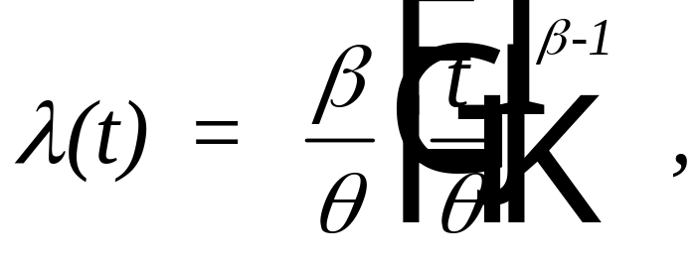
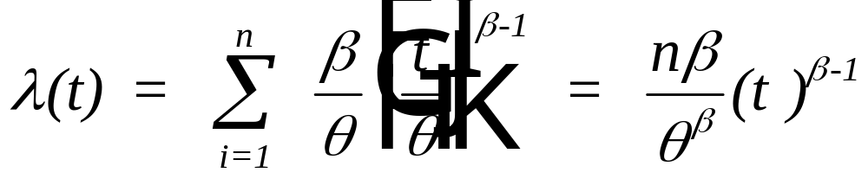
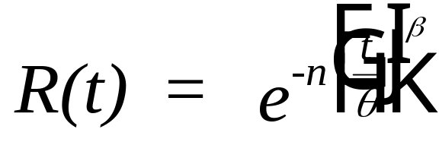
Identical Weibull Components
n components have identical hazard rate functions:
then
and
Chapter 4
Notes:
If both the scale and shape parameters are identical for all failure modes then the above result is obtained. When would all the failure modes have the identical distribution? Can you provide an example? What is the characteristic life of the system?

Slide 21
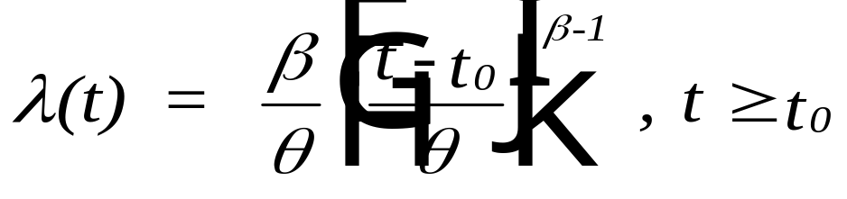
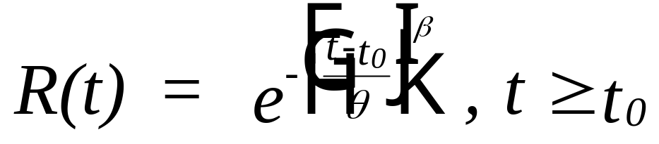
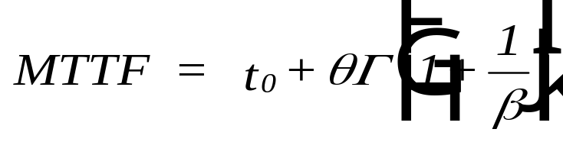
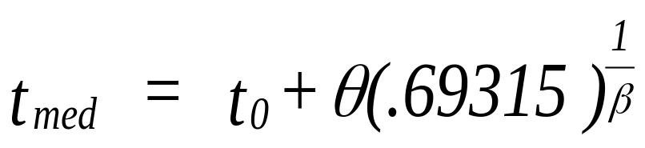
Three Parameter Weibull
Let t₀ be the minimum life such that T>t₀, then
Chapter 4
Notes:
If a minimum life is present, then a third (location) parameter is included. It is a location parameter and the modification to the distribution is similar to that of the two-parameter exponential.

Slide 22
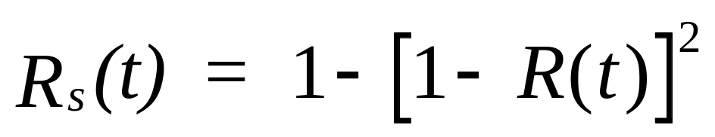
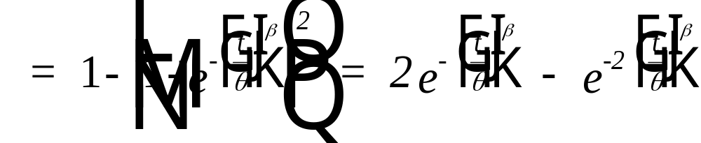
Redundancy - Two Identical Weibull Components
Chapter 4
Notes:
For two identical and independent Weibull components that are redundant, a system reliability function is obtained. It should be clear that the above reliability function is not from a Weibull distribution.

Slide 23

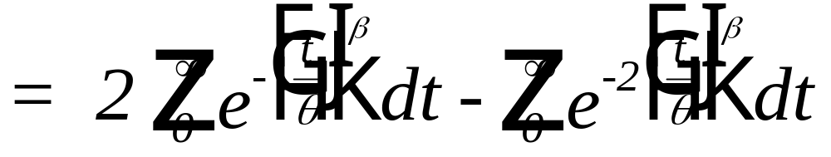
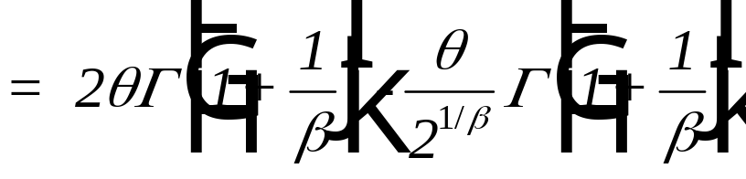
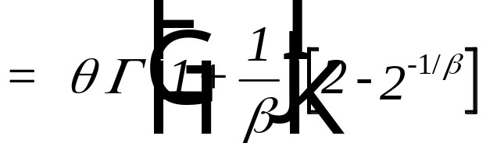
MTTF - Redundant Weibull Components
Chapter 4
Notes:
With a little effort, the MTTF for this two-component, redundant system is derived. How much effort would it have taken you to derive if the intermediate steps were not provided?

Slide 24
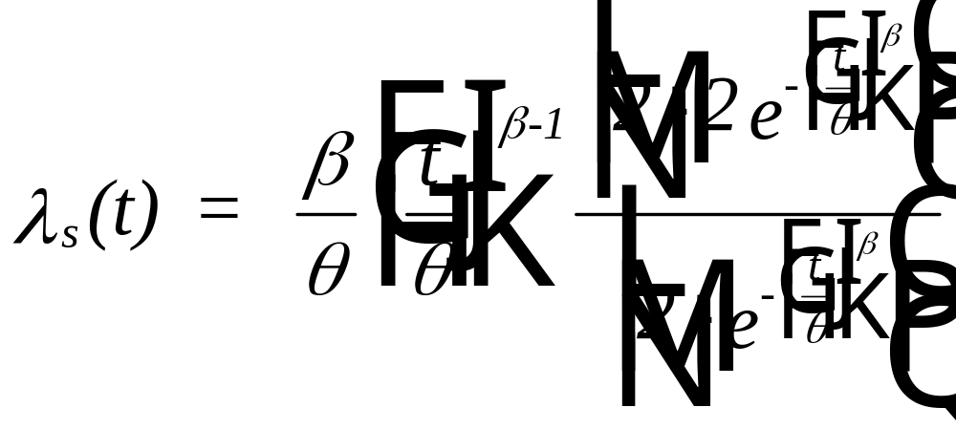
Hazard Rate Function
Redundant Weibull Components
Chapter 4
Notes:
The hazard rate function for the two-component redundant system. The derivation is on the next slide. However, you will probably want to derive it yourself first.

Slide 25
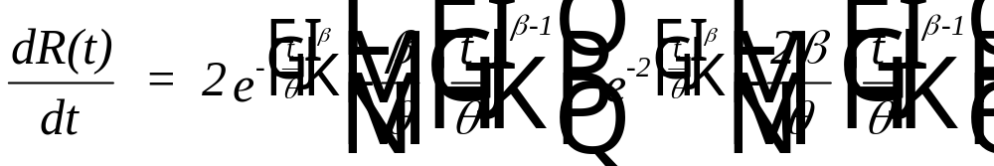
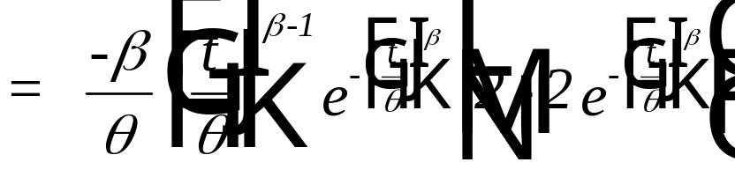
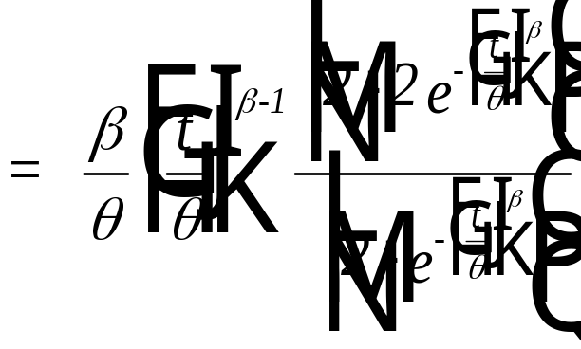
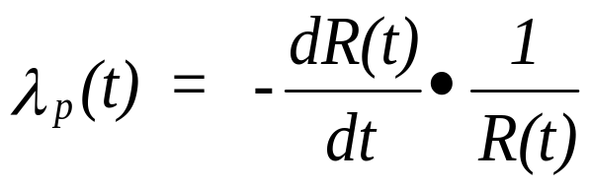
Derivation of Hazard Rate Function
2 component redundant system
Chapter 4
Notes:
What happens to the hazard rate as t approach infinity?

Slide 26
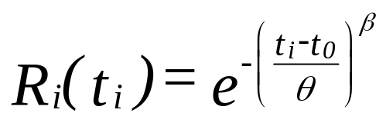
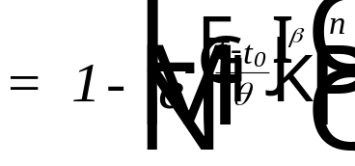
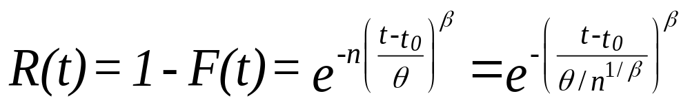
Minimum Extreme Value Distribution
Appendix 4C
Let T_{i} = failure time of i^{th} component, then
with T = min{t₁, t₂, … , t_{n}}
Chapter 4

Slide 27
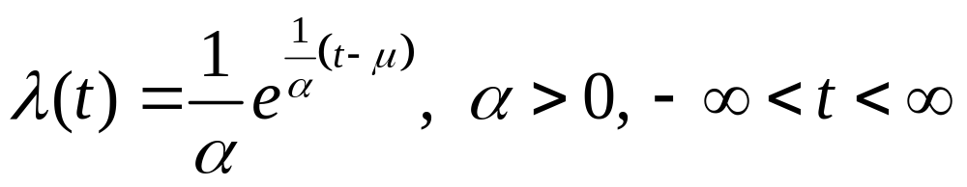

Minimum Extreme Value Distribution
- the Limiting Distribution
Assume the hazard rate function increases exponentially
Chapter 4

Slide 28


Minimum Extreme Value Distribution
Chapter 4

Slide 29


Median time to failure
The location parameter, μ, is the mode of the distribution
Chapter 4

Slide 30


The minimum extreme for α = 3 and μ = 12
Chapter 4

Slide 31

Relationship with the Weibull
letting t = ln x, α = 1/β and μ = ln θ where x > 0
Chapter 4

Slide 32

Student Exercise - Weibull
A certain brand lightning arrester has a Weibull failure distribution with a shape parameter of 2.4 and a characteristic life of 10 years. Find:
a. R(5 yrs)
b. MTTF
c. Standard deviation
d. Median and Mode
e. 99% (B1) and 95% B(5) design life
f. R(5|5)
Chapter 4
Notes:
You must have been looking forward to this. Your very own example to work.

Slide 33



Student Exercise - solution
Chapter 4
Notes:
Surely you have gotten these answers?

Slide 34


Student Exercise - solution (continued)
Chapter 4
Notes:
And these!

Slide 35

Student Exercise - solution (continued)
Chapter 4
Notes:
And this! Be sure you have mastered all facets of the Weibull distribution before moving on the the next one, the normal probability distribution. The Weibull will certainly become one of your all time favorites.

